Slide 1

Field Marshall Training

Slide 2

Table of Contents
Mission Statement
Field Marshalls
Players
  Injuries
  The Game
Referee
  Abuse
  Paul’s Place
Coaches/Spectators
Fields
  Weather
  Animals

Slide 3
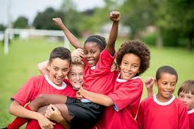
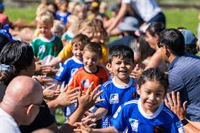
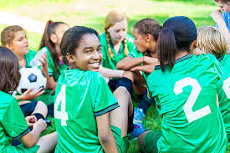
Field Marshall Mission Statement
Our mission is to help provide a safe, supportive, and fun environment where athletes can develop their soccer skills, build character, and grow a lifelong love for the game. We are committed to promoting teamwork, sportsmanship, and personal growth while fostering a positive atmosphere for all players, coaches and families.

Slide 4


Field Marshall Safety
Take care of yourself! Put on sunblock, stay hydrated and stretch before your shift. Remember to wear your vest when working.
Never put yourself in harms way
  Do not try to break up fights
  Even though the snakes are cute do not play with them
  Do not drive the golf carts recklessly or across game fields
Report fights or unruly spectators. Understand how to approach mass confrontation.
  Just being present can calm crowds down
  Know when/how to speak to offender. Do not raise voice, walk them away from focused area
  They want to be heard, so listen
  If coach/spectator is not accepting, stay in area but back off and call for assistance.
  Know when to tell offender to leave – Do not do this alone and report it to league director
Go to where the noise is – prevent escalation before it happens
  Preventing something from escalating keeps everyone safer

Slide 5
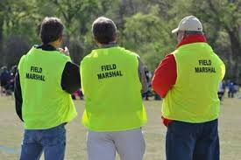
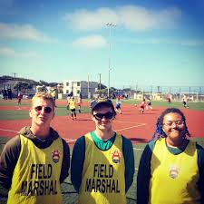
Field Marshalls
Responsibilities
Safety is our priority!
  Players, referees, coaches, families and ourselves
Help ensure games start on time and all referee crews are present
Stop/report referee abuse
Report traffic issues
Field maintenance
Weather notifications
Animal control
Assist with directions to fields, bathrooms, vendors and referee shack
Lost and found
Enforce photographer/media rules
Handout the link for the Referee Feedback Form
Complex Field Marshall
Phone # 505-440-0153

Slide 6
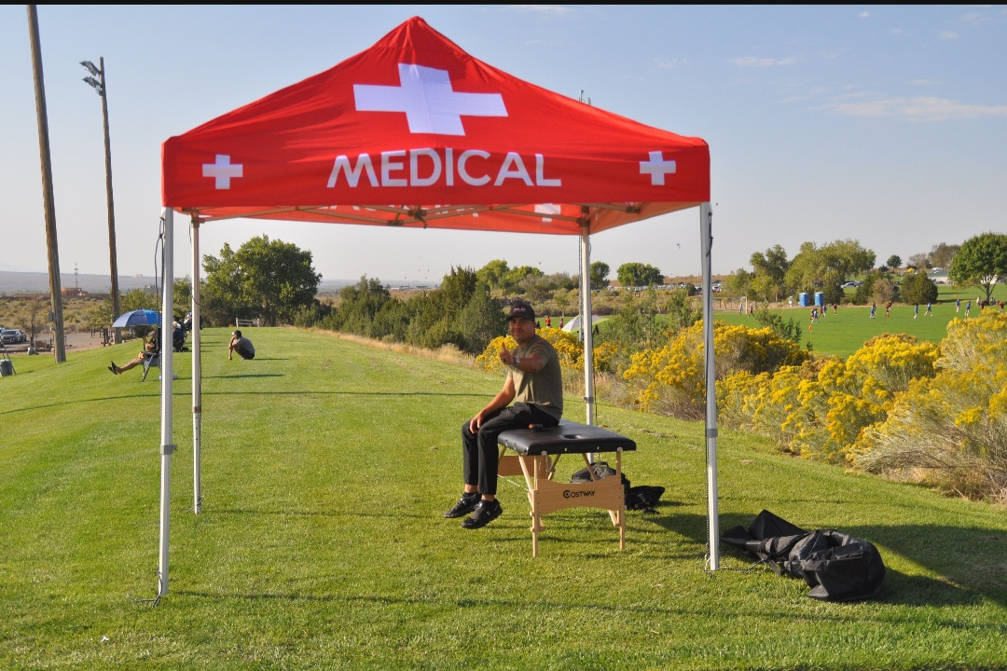
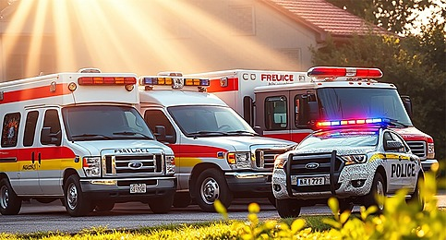

Players
Injuries
  Alert medical staff to field with injury
    Know if trainer is onsite? Where are they located? How many trainers are there?
    You can ask coach or player if they want a trainer before you call a trainer to every injury
    Trainers can walk to field if close by otherwise golf carts rides can get the trainers to the injured player faster to provide better care for the players.
    Do not try to assess yourself, wait for trained staff
    Complete New Mexico Youth Soccer Association (NMYSA) injury report form
  Offer to bring Ice Bags
  Emergency Vehicles
    Notify field director and/or league director
    Know procedures for getting emergency vehicles in/out of complex
    Assist with navigating traffic – block off traffic or midway if needed
Assist referees with players safety
  Rules and age limit for heading
  Know the signs of heat stroke, dehydration or hypothermia

Slide 7

The Game
Remember every game is the World Cup!
Go online and understand league/tournament rules
  Could vary at each event
  Number of players, club pass rules, age bracket rules (headers, game time), scoring system, overtime rules, what matches need winners
  Contact league/referee director to clarify rules if needed
  Direct teams to where and when they may warm up before matches.
Player cards/Roster
  Player is not allowed to play if player card and/or picture roster is not available. League/tournament director is the only authorized person to approve player.

Slide 8
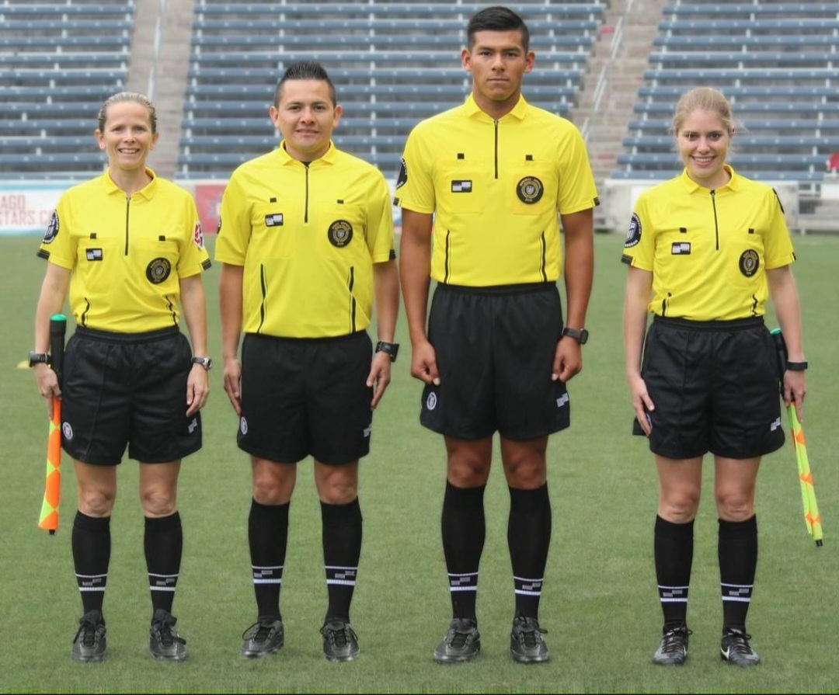
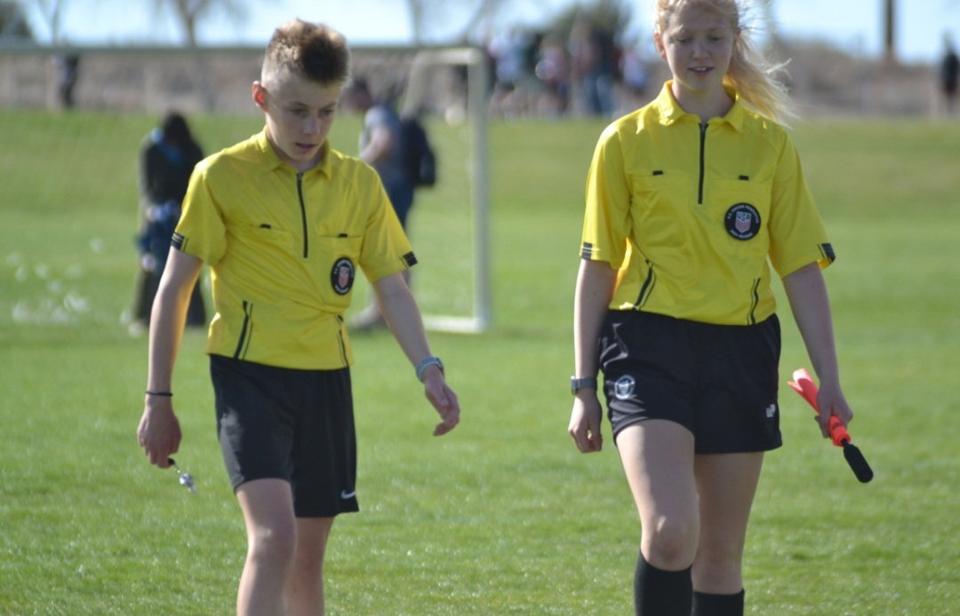
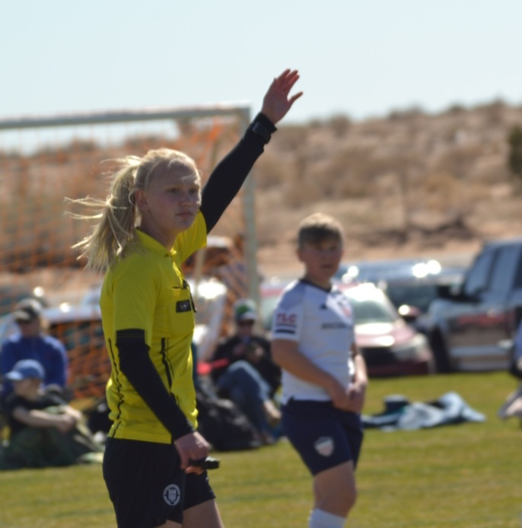
Referee
Introduce yourself and offer to assist them with net and field problems
Help ensure games start on time and all referee crews are present
  If time permits, use golf carts to help get referees to next game
Missing referee
  Have other referee complete player check in and coin toss
  Notify referee assignor is any are missing and who is missing
Keep them hydrated
  Have extra waters to hand out
Protect referee team, encourage them and take care of them. Do not distract them.
Encourage refs to remove jersey when not refereeing. This could cause unwanted attention from spectators, players or coaches.

Slide 9
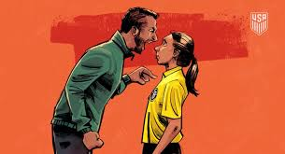
Referee Abuse
Be familiar with the spectators No Tolerance Policy and Coaches/Players 531-9 policy
Know the rules for referee abuse
  Non-physical - verbal taunting, harassment, intimidation, threats, derogatory language, offensive or discriminatory act
  Physical – minor or slight touch, intentional confrontation, violent contact
  Be prepared to submit a detailed written report. Penalty may occur and/or result in removal from the complex and suspension.
  If needed, drive referee crew to safe place. If player(s) are injured stay with player(s) and have referees drive themselves if old enough.
  Never offer or discuss the referee’s actions, you may clarify the laws of the game to uninformed spectators for the good of the game if you are a referee and know the laws of the game. If in doubt keep your mouth shut and smile!
    Offer referee feedback forms for spectators or coaches that are extra unruly. This sometimes make them feel heard and will de-escalate the situation.

Slide 10
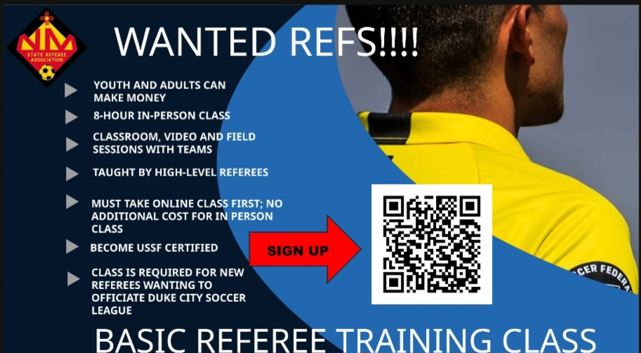
Recruit
  We have a referee shortage. Encourage others to sign up for class, especially if they think they know more then everyone on the field.
  Know about the referee mentorship program

Slide 11
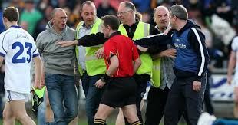
Coaches/Spectators
Abuse
  No tolerance from coaches, players or spectators
  Respect the referee call
  See if anyone recorded event
    Videos help determine cause/effect and used for mentoring/training
    Will not be used to change calls
  At no time shall any spectator’s come into physical contact with another person
    Report immediately if an adult has physical contact with any youth person (player/family/referees)
    Call police if needed
Are teams on correct field and correct side of field
  Be familiar with number of coaches allowed on team sideline
Enforce spectators to remain behind blue lines during all matches
  Allows referees to have free space to run lines
  Keeps spectators off field
  If you can catch early enough ask nicely for them to relocate, referees can help enforce
No spectators are allowed behind goals or on team side.
  Exceptions can be allowed if they are on the team side not coaching players
    Ex: Family is sitting in the shade and is quite or only cheering, not interfering with players/game

Slide 12
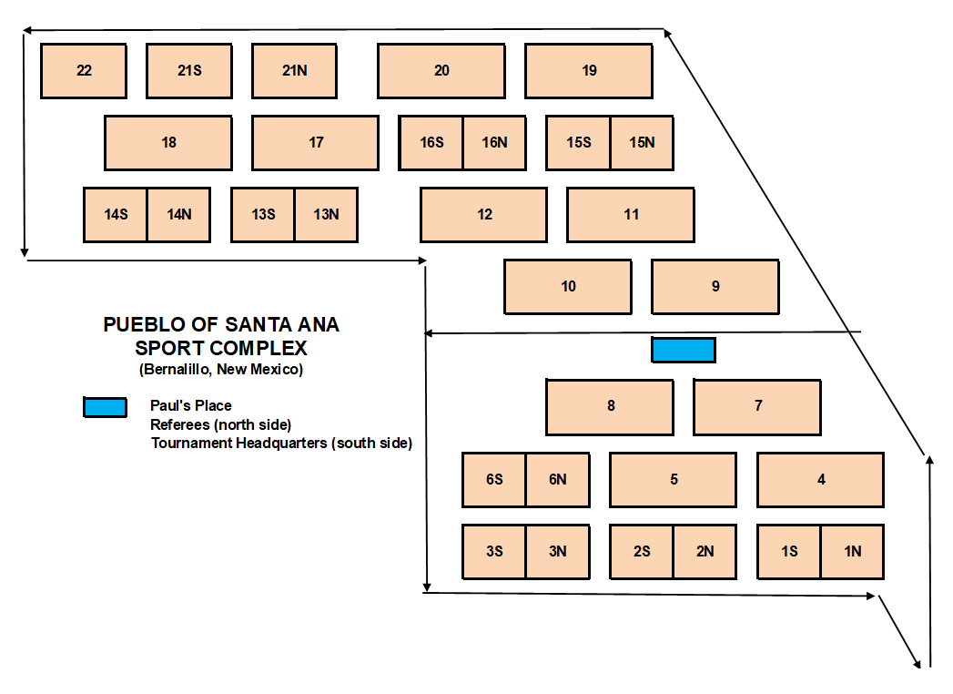
Field Map
North
Entrance

Slide 13


Fields
Goals
  Ensure goals/nets are secured and no gaps exist
    Zip ties are available to secure nets (do not use tape)
Ensure fields have flags on corners and secured
  Keep kids from playing with the flags
Sprinklers
  If you notice a sprinkler head raised above ground, gently and lightly tap the top of sprinkler to allow it to drop into ground
Report Port-Potty problems to the league or tournament director
Help pick up trash and encourage team/spectators to pick up their trash

Slide 14
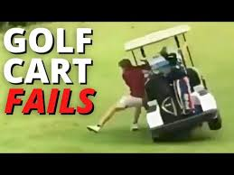
Fields Continued
Golf carts
  Know where golf carts are allowed and not allowed to drive.
    DO NOT drive across fields unless there is an injury in which the player is unable to walk.
  Must have driver’s license to drive carts and permission from league/tournament director
  Watch out for kids! They like to run after you or hide under the cart when stopped
  Carts can tip over when driving on the hills.
    Ensure weight is evenly distributed on cart and never carry more than the seats available.
  If you are not in need for anything else you can help older or disabled spectators, get to their field. Drive with caution, as you don’t want them to fall out or get hurt.
  Assist league/tournament directors with anything they need

Slide 15
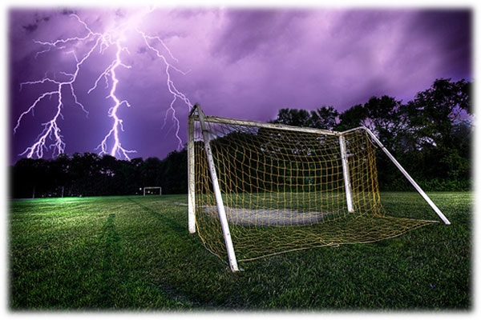
Weather
Know lightning procedures
  Referees will have control to delay or stop match
  Complex Weather Notification Alarm (once sounded takes control over the referee)
    Long siren – everyone clear fields, cannot be overruled
    Siren will alarm every 5 minutes until danger passes
    Double tone alarm means all clear and can resume play
      Usually happens after at least 30 minutes after last lightning strike
      Follow league/tournament director’s instruction for restart, and report if field is not playable.
  Help notify teams if delay or cancelation happens

Slide 16
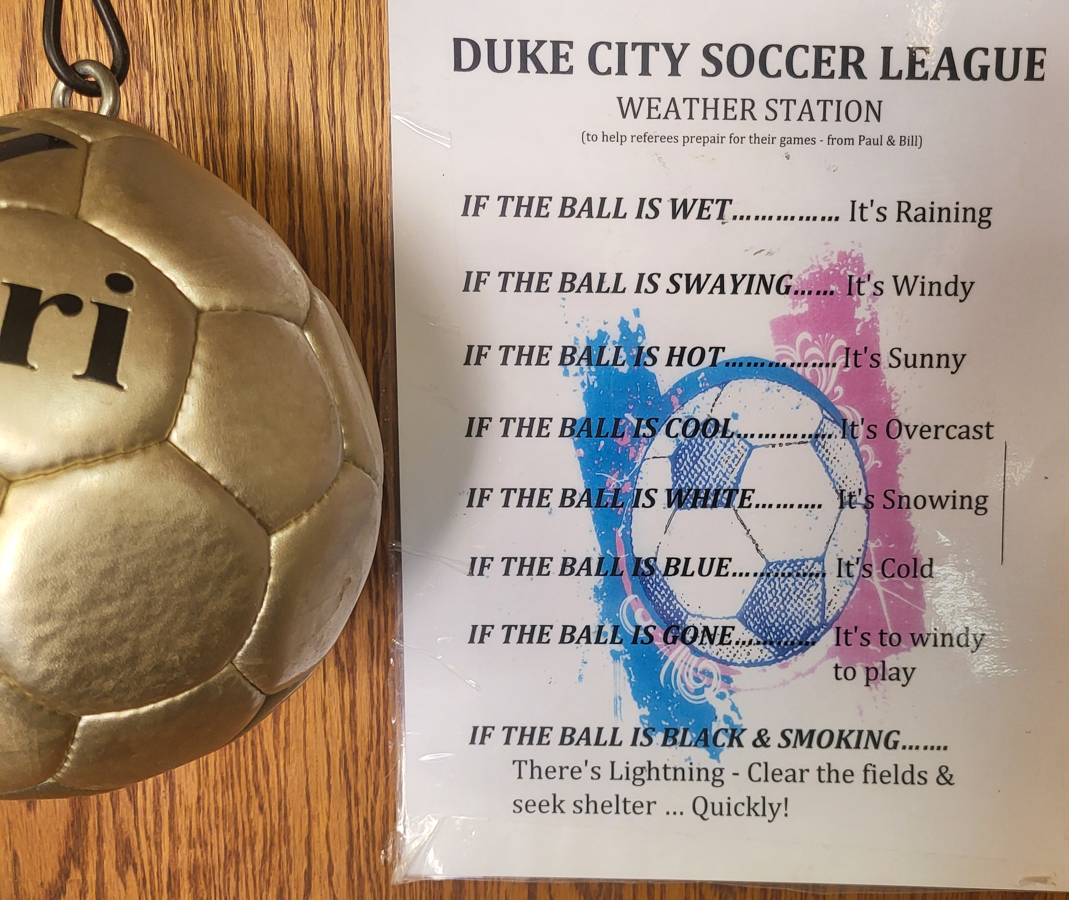
Weather Continued
Wind is our enemy.
  Video cameras must be mounted/staked or weighted down per manufacturer instructions.
    Ask coach to take down if it can’t be weight it down. If coach doesn’t comply, report to league/tournament director.
  Maintain tents/canopies/umbrellas
    Could cause injuries if not weighted down
  Watch for goals lifting or blowing over
    Notify league director if this happens

Slide 17

Animals
No dogs allowed – signs all over complex
  Exception service animals
  Pueblo police could remove animal from complex
    Could include fine
  No other animals allowed either
Watch for snakes, bobcats, mountain lions, etc.
  Keep everyone out of the “bad areas”
  Know procedures for snake relocation

Slide 18
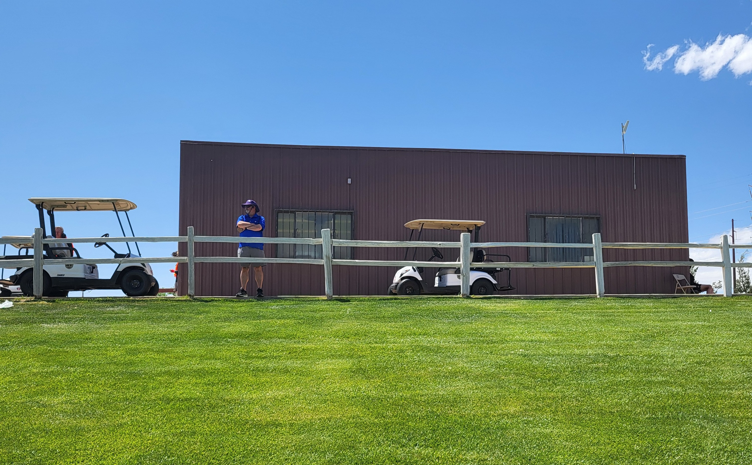
Paul’s Place – Referee Shack
Located on top of hill between fields 7 & 9
For Tournaments this building will hold both the tournament headquarters and referees
  Tournament Headquarters will be on the south side of the building
    Upset Coaches or parents should only be sent to the
south side of this building.
  Referee area will be on the north side (also the referee
payout location)
Lost and Found
  Located south entrance
WiFi
  Can be used by anyone that needs it – Network is named: PSASoccer / Password: score1goal
INSERT
PICTURE
HERE

Slide 19
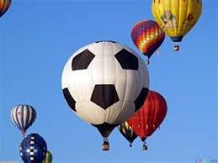
Miscellaneous
Hot Air Balloons
  Are not allowed to land on fields unless emergency
    Must declare emergency landing
Parking
  No parking in emergency vehicle access zones
    Contact league/field director
  Report accidents/issues to league/field director
  Traffic
    May need to assist with traffic – block off midway if entrance gates are backed up
Vendors
  Must be approved or will be fined and removed from the complex

Slide 20
Questions?
Contact league/tournament directors

